Slide 1
Introduction to Web Design and HTML
UNIT-3

Slide 2
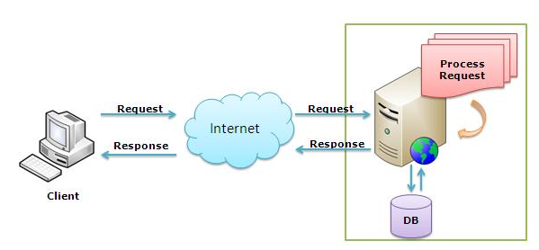
Client/Server Architecture
Server

Slide 3
Web Client/ Web Server
Web Server
Web server receives a client request, process the request and give response to the client.
Allows to host the web sites
Web Client
A web client is an application that communicates with a web server, using Hypertext Transfer Protocol (HTTP)
Web browser is a software that acts as a web client.

Slide 4
Clients & Servers Example
Clients (Browser)
Internet Explorer
Firefox
Mozilla
Netscape
Opera
Amaya
AOL
MSN
Servers
Apache
IIS Web Server.
Litespeed server
Google Web server(GWS)
Oracle iplanet WebServer

Slide 5
Web Essentials
“Web”- short for “World Wide Web”
A web page is a simple text file written in a markup language (called HTML)
A website is a group of HTML files that are stored on a hosting computer which is permanently connected to the internet
URL - Uniform Resource Locator - used to indicate a resource on the Internet
Home page -The main page on a particular Web site or index page

Slide 6
How the browser interacts with the servers ?
User enters the URL(Uniform Resource Locator) of the website or file. The Browser then requests the DNS(DOMAIN NAME SYSTEM) Server.
DNS Server lookup for the address of the WEB Server.
DNS Server responds with the IP address of the WEB Server.
Browser sends over an HTTP/HTTPS request to WEB Server’s IP (provided by DNS server).
Server sends over the necessary files of the website.
Browser then renders the files and the website is displayed. This rendering is done with the help of DOM (Document Object Model) interpreter, CSS interpreter and JS Engine collectively known as the JIT or (Just in Time) Compilers.

Slide 7
Domain Name, URL’s and IPs
Uniform Resource Locator (URL):
http://www.microsoft.com/faqs.html
Domain name: The specific address of a computer on the Internet
microsoft.com
Internet protocol (IP) address
192.168.1.1

Slide 8
Structure of a Uniform Resource Locators
protocol
pathname
http://www.chicagosymphony.org/civicconcerts/index.html
Domain name
filename
http => Hypertext Transfer Protocol

Slide 9
Mapping IP to Domain Name
Domain Name System – a mapping between the human-readable name (domain name) of a host and its IP address
http://www.kongu.edu/department/CSE/index.html
http: – specifies the protocol
www.kongu.edu – specifies the host name / domain name
/department/CSE/index.html– specifies the path of the document on the host

Slide 10
Internet Use
Send e-mail messages.
Send (upload) or receive (down load) files between computers.
Participate in discussion groups, such as mailing lists and newsgroups.
Surfing the web.
Social media etc..

Slide 11
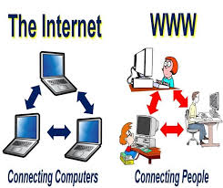
Internet Vs WWW

Slide 12
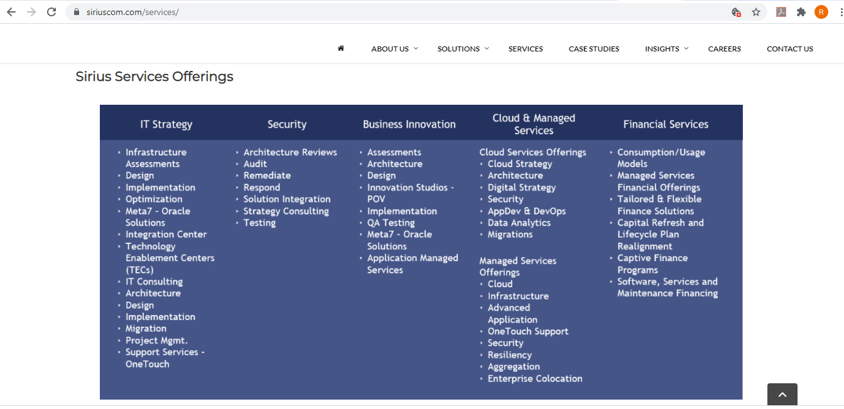
Web Page - The Making of a Good Design
Content is important, but content alone will not make your site work.
Good Design is:
Understandable
Interesting
Easy to use
Uniform in look and feel
Done from a visitor’s point of view:
WYSIWYW (What You See Is What You WANT)
Notes:
Biggest mistake in web design is to build a site for the designer, not the user.
Users expect sites to be flawless.
Looks matter. Site should be pleasing to the eye. Site should evoke trust and value.

Slide 13
Technologies & Tools
Markup Languages
HTML, XHTML, XML, XSLT, etc....
Cascading Style Sheets (CSS)
Scripting languages
Client-side: javascript, VBScript
Server-side: perl, NodeJS, php, JSP, Servlet etc....
Web creation and editing software
Notepad, FrontPage, Flash, Site Builder etc..
Frameworks
Angular JS
React JS

Slide 14
Web Page Vs Website
A Web page is a document in the World Wide Web that is identified uniquely by a uniform resource locator (URL) and is displayed in a web browser
Called as Pages
A collection of related web pages located under a single domain name.
Called as Web Sites

Slide 15
HTML-Hyper Text Markup Language
To Create Web pages.
Uses tags, to tell the Web browser software how to display the text contained in the document
HTML tags are not case sensitive
HTML documents are described by HTML tags
File Extension: .html, .htm, .xhtml
Tools:
Notepad , Notepad++[any text editor]
Web Browsers (Internet Explorer, Firefox, Chrome, etc..)

Slide 16
HTML – Fundamentals Document Structure
< HTML >
<Head> <!- optional tag - - >
<Body>
< / HTML>

Slide 17
HTML – Basic Structure
<html>
<head> <! - - optional tag- ->
<title> The title of your html page </title>
</head>
<body>
<! - - your web page content and markup - ->
</body>
</html>

Slide 18
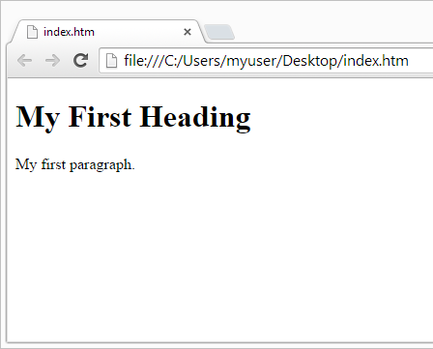
Example
<!DOCTYPE html> <html> <head> <title>Page Title</title> </head> <body> <h1>My First Heading</h1> <p>My first paragraph.</p> </body> </html>

Slide 19
Description
The <!DOCTYPE html> declaration defines this document to be HTML5
The text between <html> and </html> describes an HTML document
The text between <head> and </head> provides information about the document
The text between <title> and </title> provides a title for the document
The text between <body> and </body> describes the visible page content
The text between <h1> and </h1> describes a heading
The text between <p> and </p> describes a paragraph

Slide 20
HTML - Comment lines
Comments are not displayed in the browser
Starts with <!--
Ends with -->
Example:
<!--This is a comment. -->

Slide 21
HTML Tags
HTML tags are keywords (tag names) surrounded by angle brackets:
Syntax: <tagname>content goes here...</tagname>
HTML tags normally come in pairs like <p> and </p>
The first tag in a pair is the start tag, the second tag is the end tag
The end tag is written like the start tag, but with a forward slash inserted before the tag name

Slide 22
HTML Heading Tag
HTML headings are defined with the <h1> to <h6> tags
<h1> defines the most important heading
<h6> defines the least important heading
Example:
<h1>This is heading 1</h1>
<h2>This is heading 2</h2>
<h3>This is heading 3</h3>
<h4>This is heading 4</h4>
<h5>This is heading 5</h5>
<h6>This is heading 6</h6>

Slide 23
HTML ATTRIBUTES
Attributes provide additional information about HTML elements
All HTML elements can have attributes
Attributes are always specified in the start tag
Attributes usually come in name/value pairs like: name="value“
Example
<body bgcolor=“green” >
<p> hai </p>
</body>

Slide 24
HTML colors- Attribute Values
color_name: It sets the background color by using the color name. For example “red”.
hex_number: It sets the background color by using the color hex code. For example “#0000ff”.
rgb_number: It sets the background color by using the RGB code. For example: “RGB(0, 153, 0)” .
<BODY bgcolor=“blue”>
<BODY bgcolor=“rgb(255,0,0)” >
<BODY bgcolor=“#0000FF”>
https://htmlcolorcodes.com/

Slide 25
HTML -Colors
Color is the combination of red, green and blue
color = “red” (Browser compatibility issues)
color=“rgb(122,255,0)”
color = “#FF0000”
values vary from 00 to FF (hexadecimal)
0,1,2,3,4,5,6,7,8,9,a,b,c,d,e,f
#FF FF FF
Red
Blue
Green

Slide 26
HTML Links- anchor tag
HTML links are defined with the anchor tag<a>
Example
Test.html
<a href="http://www.kongu.ac.in"> kongu</a>
The link's destination is specified in the href attribute

Slide 27
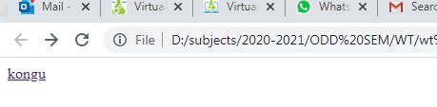
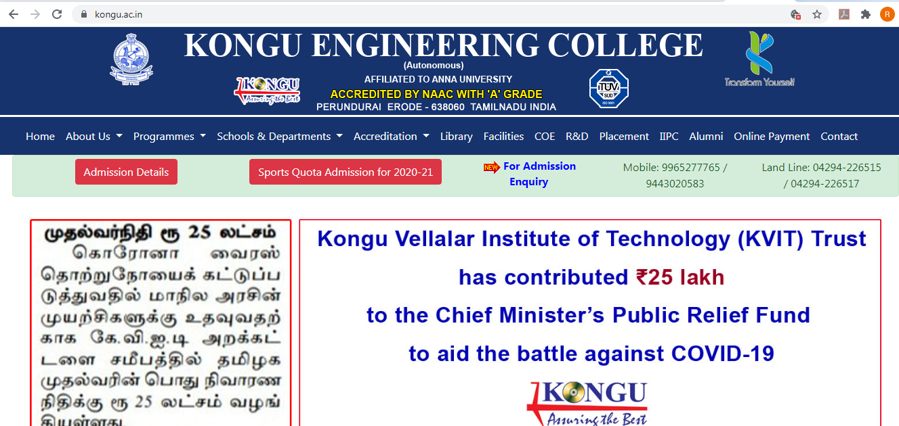
Example output
Test.html

Slide 28
HTML Links
Test.html
<body>
<a href=“bio.html”> Read my BIO </a>
<body>
bio.html
<body>
Welcome to web Page
</body>

Slide 29
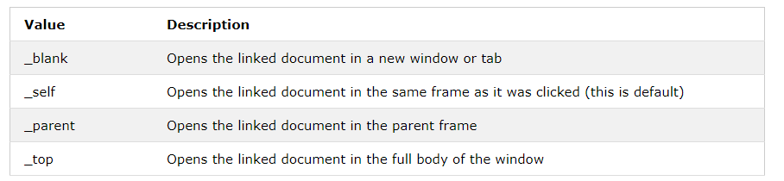
<anchor > - Target attribute value
Target=“value”
Value can be

Slide 30
Hypertext links
<a href=“bio.html” target=“_blank” > BiO DATA </a>
Creates new window for the page
<a href=“bio.html” target=“_self” >Bio Data</a>
Opens page in the same tab

Slide 31
HTML Images
HTML images are defined with the <img> tag
The source file (src), alternative text (alt), and size (width and height) are provided as attributes
alt: Alternate text is used when the image cannot be displayed
Example:
<img src=“ group.jpg" alt="Tour" width="600" height="300“/>

Slide 32
HTML Element-<img>
Images from local folder
<img src=“image1.jpg" alt=“Image here" width=“100" height=“150">
(OR)
Images from different folder
<img src="/images/html5.gif" alt=“HTML5 Icon” width=“28px” height=“128px”>
Images from other servers
<img src="https://www.kongu.ac.in/images/logo.jpg" alt=“KEC LOGO">

Slide 33
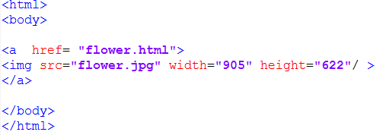
Image as hyper link

Slide 34
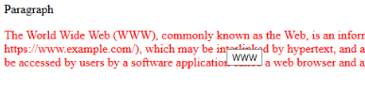
The title Attribute
title attribute is added to the <p> element
The value of the title attribute will be displayed as a tooltip when you move the mouse over the paragraph
Ex:
<p title=“KEC">
Kongu Engineering College
</p>
<!DOCTYPE html>
<html>
<head> Paragraph</head>
<body>
<p title="WWW“ >
The World Wide Web (WWW), commonly known as the Web</p>
</body>
</html>

Slide 35
Nested HTML Elements
HTML elements can be nested (elements can contain elements)
<p><h2>My first paragraph</h2></p>

Slide 36
HTML Empty Tags
<br> --- line break
<hr> --- horizontal rule

Slide 37
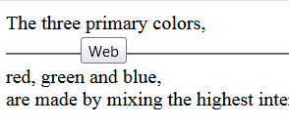
Horizontal Rule and break tag
The <hr> tag defines a thematic break in an HTML page
It is most often displayed as a horizontal rule
<br> tag:
To display in next line in web page
No ending tag
<html>
<body>
<p title="Web"> The three primary colors, <hr> red, green and blue, <br> are made </p>
</body>
</html>

Slide 38
HTML Display
With HTML, we cannot change the output by adding extra spaces or extra lines in your HTML code.
The browser will remove any extra spaces and extra lines when the page is displayed
Ex:
<p> This paragraph contains a lot of spaces in the source code, but the browser ignores it. </p>

Slide 39
HTML <pre> Element
The HTML <pre> element defines preformatted text.
The text inside a <pre> element is displayed in a fixed-width font (usually Courier), and it preserves both spaces and line breaks
<pre> </pre>
Ex: Poem – line by line

Slide 40
HTML Formatting Elements
HTML also defines special elements for defining text with a special meaning.
HTML uses elements like <b> and <i> for formatting output, like bold or italic text
<b> - Bold text
<strong> - Important text
<i> - Italic text
<em> - Emphasized text
<mark> - Marked text
<small> - Small text
<del> - Deleted text
<ins> - Inserted text
<sub> - Subscript text
<sup> - Superscript text

Slide 41
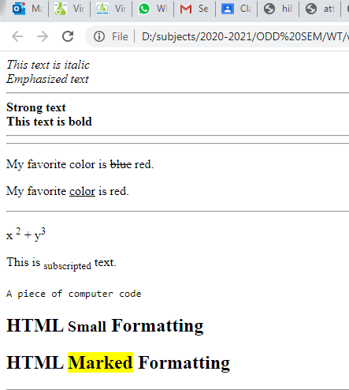
Output of Formatting tags

Slide 42
HTML Lists
Unordered List
Item
Item
Item
Item
Ordered List
Item
Item
Item
Item

Slide 43
HTML Lists
Unordered list
<ul type=“square”>
<li>apples</li>
<li>bananas</li>
<li>grapes</li>
<li>strawberries</li>
</ul>
Ordered list
<ol type=‘i’ start=‘2’>
<li>apples</li>
<li>bananas</li>
<li>grapes</li>
<li>strawberries</li>
</ol>

Slide 44
HTML Lists
Unordered list
apples
bananas
grapes
strawberries
Ordered list
apples
bananas
grapes
strawberries

Slide 45
Unordered HTML List- type attributes
An unordered list starts with the <ul> tag
Each list item starts with the <li> tag.
The list items will be marked with bullets (small black circles) by default
Value | Description
disc | Sets the list item marker to a bullet (default)
circle | Sets the list item marker to a circle
square | Sets the list item marker to a square
none | The list items will not be marked

Slide 46

Ordered HTML List type attributes
An ordered list starts with the <ol> tag
Each list item starts with the <li> tag
The list items will be marked with numbers by default
Type | Description
type="1" | The list items will be numbered with numbers (default)
type="A" | The list items will be numbered with uppercase letters
type="a" | The list items will be numbered with lowercase letters
type="I" | The list items will be numbered with uppercase roman numbers
type="i" | The list items will be numbered with lowercase roman numbers

Slide 47
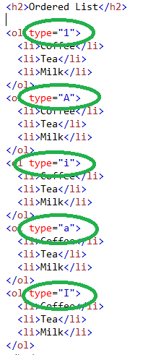
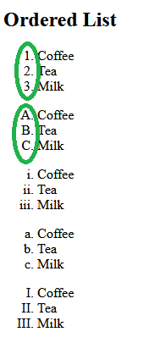
HTML Elements-Ordered List

Slide 48
How to design a nested list?
Coffee
Tea
Black tea
Green tea
Milk

Slide 49
Nested HTML Lists
List can be nested - lists inside lists
Example:
<ol>
<li>Coffee</li>
<li>Tea
<ul>
<li>Black tea</li>
<li>Green tea</li>
</ul>
</li>
<li>Milk</li>
</ol>

Slide 50
HTML Tables
An HTML table is defined with the <table> tag.
Each table row is defined with the <tr> tag
A table header is defined with the <th> tag. By default, table headings are bold and centered.
A table data/cell is defined with the <td> tag

Slide 51
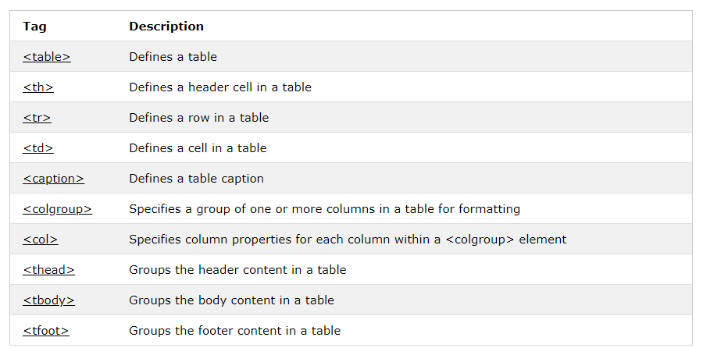
HTML Table tags

Slide 52
HTML TABLES
<table>
Style, border….
<tr> --- Table row
<td> --- Table data
Attribute— rowspan, colspan
text, images, lists, other tables, etc.
<th> --- Table header
Attribute— colspan ,rowspan

Slide 53
<thead>, <tbody>, <tfoot>
<table border = "2">
<caption><strong>Table of Fruits and Their Prices </strong></caption>
<thead>
<tr>
<th>Fruit</th>
<th>Price</th>
</tr>
</thead
<tbody>
<tr>
<td>Apple</td>
<td>100</td>
</tr>
<tr>
<td>Orange</td>
<td>50</td>
</tr>
</tbody>
<tfoot>
<tr>
<th>Total</th>
<th>150</th>
</tr>
</tfoot>
</table>

Slide 54
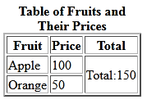
ROWSPAN
Cell that spans two rows (Merged tow rows)
<tbody>
<tr>
<td>Apple</td>
<td>100</td>
<td rowspan="2">Total:150</td>
</tr>
<tr>
<td>Orange</td>
<td>50</td>
</tr>
</tbody>

Slide 55
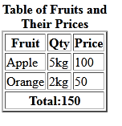
COLSPAN
Cell that spans two columns (Merged tow columns)
<tfoot>
<tr>
<th colspan="3">Total:150</th>
</tr>
</tfoot

Slide 56

Colgroup
Set the background color of particular columns with the <colgroup> and <col> tags
<table border="1">
<colgroup>
<col span="2" style="background-color:red">
<col style="background-color:yellow">
</colgroup>
<tr>
<th>ISBN</th>
<th>Title</th>
<th>Price</th>
</tr>
<tr>
<td>3476896</td>
<td>My first HTML</td>
<td>$53</td>
</tr>
</table>

Slide 57
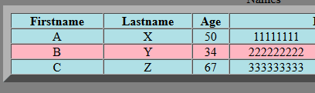
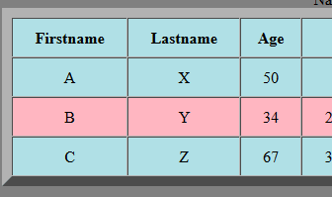
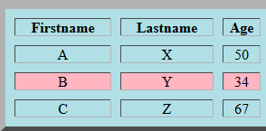
CELL PADING vs CELL SPACING
CELL PADING: Spacing between text and cell
CELL SPACING: Spacing between two cells

Slide 58
Question
Design a table like this

Slide 59
HTML-Internal Linking[bookmarking]
Used to create linking or book marking within a page
Page should exceed more than one page
Example:
<body>
<h1 id = "books">my favourite books</h1>
<p><a href = "#languages">Go to Favorite languages</a></p>
<ul>
……………..
<h1 id = "languages">My Favorite languages</h1>
<p><a href = "#books">Go to Favorite books</a></p>
<ol>
………..

Slide 60
Media Tags
Multimedia on the web is sound, music, videos, movies, and animations.
Multimedia comes in many different formats. It can be almost anything you can hear or see, like images, music, sound, videos, records, films, animations, and more.
Multimedia Formats :Multimedia files have formats and different extensions like: .wav, .mp3, .mp4, .mpg, .wmv, and .avi.
Common Video Formats – MP4, WebM, and Ogg

Slide 61
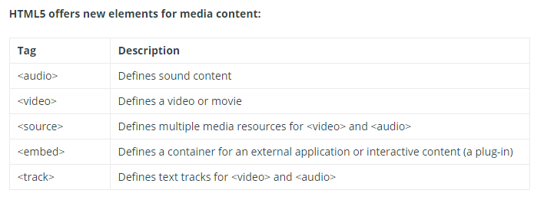
Media Tags

Slide 62

Media Tags - <audio>
The HTML <audio> element is used to play an audio file on a web page.
The controls attribute adds audio controls, like play, pause, and volume.
<audio controls>
<source src=“sample.mp3" type="audio/mp3">
</audio>

Slide 63
Media Tags - <video>
The HTML <video> element is used to play an video file on a web page.
The controls attribute adds video controls, like play, pause, and volume.
Autoplay – (does not supported in all browser)
<video width="320" height="240" controls>
<source src="movie.mp4" type="video/mp4">
</video>

Slide 64

Video Tag- example

Slide 65
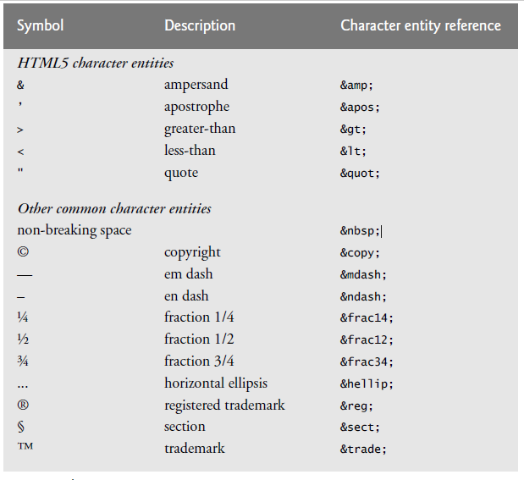
Special characters in HTML

Slide 66
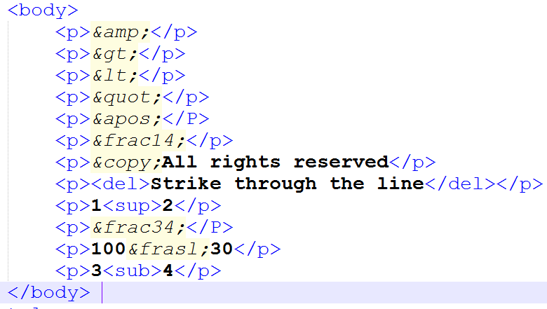
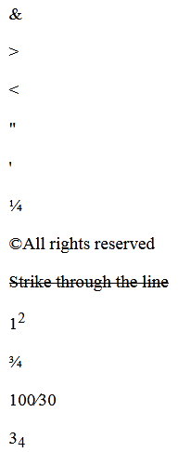
Special characters in HTML

Slide 67
HTML Quotations and Citation Elements
<q></q>
Inserts quotation marks “….”
<abbr></abbr>
Abbreviation title can be given - gives useful information to browsers.
<address></ address>
Contact information - displayed italic, adds line break
<cite></ cite>
To define the title of creative work- usually italics
<bdo></bdo>
Bi-directional override.
Used to override the current direction.

Slide 68
<Div> & <Span> tag
HTML Block (DIV) and Inline (SPAN) Elements
<DIV>
defines a division or a section in an HTML document
used as a container for HTML elements - which is then styled with CSS or manipulated with JavaScript
easily styled by using the class or id attribute
example
<div>
<p>Hello! This is a paragraph.</p>
</div>

Slide 69
<Span>
an inline container used to mark up a part of a text, or a part of a document
easily styled by CSS or manipulated with JavaScript using the class or id attribute
much like the <div> element, but <div> is a block-level element and <span> is an inline element.
Example
<p>this is a <span>span tag span></p>

Slide 70
Form
The <form> tag is used to create an HTML form for user input.
The <form> element can contain one or more of the following form elements:
<input>
<label>
<textarea>
<button>
<select>
Syntax:
<form> Form Content... </form>

Slide 71


label
The <label> tag defines a label for all elements
The for attribute of <label> must be equal to the id attribute of the related element to bind them together. A label can also be bound to an element by placing the element inside the <label> element.

Slide 72
Input tag
The <input> tag specifies an input field where the user can enter data
Syntax
<input type = "value" .... />
Attributes:
Value :The initial value of the control used for all input tag
Type:Type of form control
Name:Name of the form control. Submitted with the form as part of a name/value pair
Minlength:Minimum length (number of characters) of value. Used in text, search, email, password
Size:Size of the control -Used in text, search, email, password
Checked:Whether the command or control is checked -Used in checkbox, radio

Slide 73

Input tag types
Type | Description | Basic Examples
text | The default value. A single-line text field. Line-breaks are automatically removed from the input value.
number | A control for entering a number. Displays a spinner and adds default validation. Displays a numeric keypad in some devices with dynamic keypads.
email | A field for editing an email address. Looks like a text input, but has validation parameters and relevant keyboard in supporting browsers and devices with dynamic keyboards.
password | A single-line text field whose value is obscured. Will alert user if site is not secure.

Slide 74

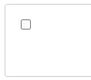

Input tag types
Type | Description | Basic Examples
radio | A radio button, allowing a single value to be selected out of multiple choices with the same name value.
checkbox | A check box allowing single values to be selected/deselected.
date | A control for entering a date (year, month, and day, with no time). Opens a date picker or numeric wheels for year, month, day when active in supporting browsers.
search | A single-line text field for entering search strings. Line-breaks are automatically removed from the input value. May include a delete icon in supporting browsers that can be used to clear the field. Displays a search icon instead of enter key on some devices with dynamic keypads.

Slide 75



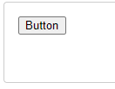
Input tag types
Type | Description | Basic Examples
file | A control that lets the user select a file. Use the accept attribute to define the types of files that the control can select.
submit | A button that submits the form.
reset | A button that resets the contents of the form to default values. Not recommended.
button | A push button with no default behavior displaying the value of the value attribute, empty by default.

Slide 76
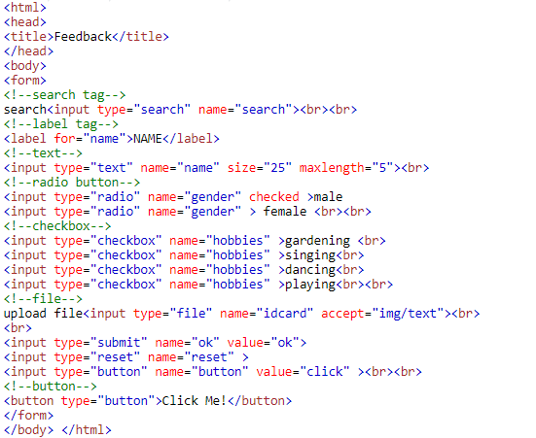
Form example

Slide 77
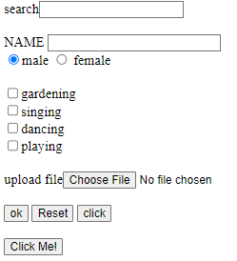
output

Slide 78


Text area
The <textarea> tag defines a multi-line text input control.
The <textarea> element is often used in a form, to collect user inputs like comments or reviews.
The size of a text area is specified by the cols and rows attributes
The name attribute is needed to reference the form data after the form is submitted

Slide 79


select
The <select> element is used to create a drop-down list.
The <select> element is most often used in a form, to collect user input.
The name attribute is needed to reference the form data after the form is submitted
The <option> tags inside the <select> element define the available options in the drop-down list.

Slide 80

button
The <button> tag defines a clickable button.
Inside a <button> element you can put text (and tags like <i>, <b>, <strong>, <br>, <img>, etc.). That is not possible with a button created with the <input> element!
Always specify the type attribute for a <button> element, to tell browsers what type of button it is.
Example
<button type="button">Click Me!</button>

Slide 81
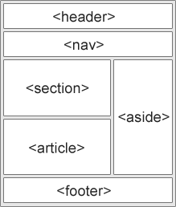
Semantic elements
Semantic elements have meaningful names which tells about type of content. For example header, footer, table, … etc.
Examples of non-semantic elements:
<div> and <span> - Tells nothing
about its content.
Examples of semantic elements:
<form>, <table>, and <article>
- Clearly defines its content.

Slide 82
Semantic tags
<header>
The <header> element represents a container for introductory content or a set of navigational links. It may contain heading or topic of the page
<nav>
The <nav> element defines a set of navigation links.
<section>
It represents the section of the document.
<article>
The <article> element specifies independent, self-contained content. It may contain User comments, Product cards, Newspaper articles

Slide 83
Semantic tags
<main>
This specifies the main page content and should be unique.
<aside>
The <aside> element defines some content aside from the content it is placed in (like a sidebar).
<footer>
The <footer> element defines a footer for a document or section. It may contain authorship information
copyright information, contact information, sitemap etc

Slide 84
